Slide 1

Cloning Types, Applications and Ethics

Slide 2
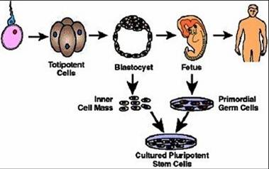
Human Embryogenesis

Slide 3
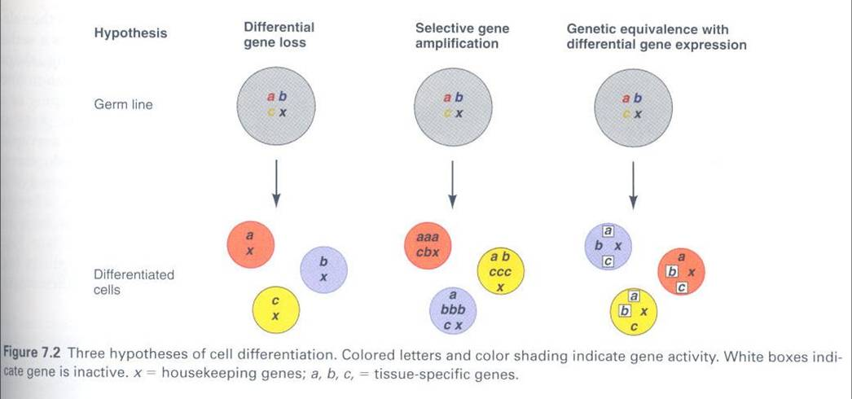
Hypotheses of cell differentiation

Slide 4
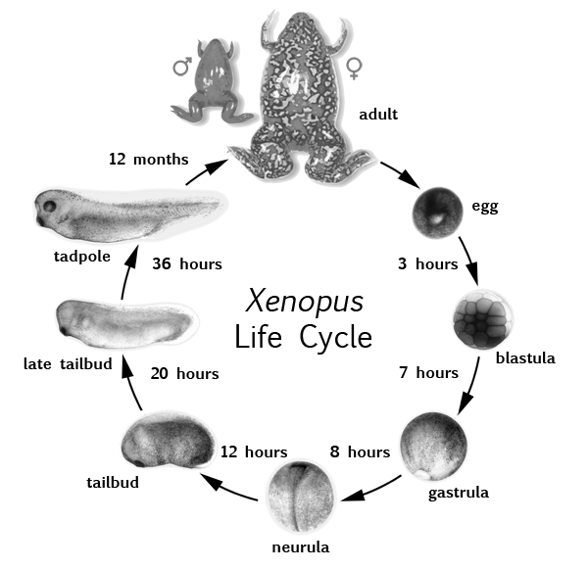
Frog Cloning

Slide 5
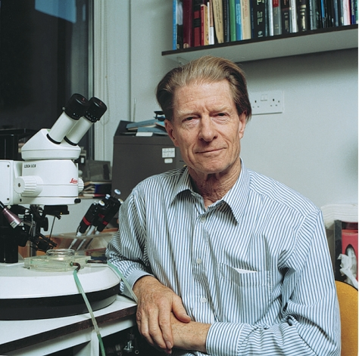
Gurdon, the Godfather of cloning
“As I was obviously deemed to
be so bad at science, I applied to
Oxford to do classics.”
Sir John Gurdon

Slide 6
Totipotency of nuclei from differentiated animal cells
Gurdon (1962) using Xenopus laevis amphibian species with a different technique.
Gurden employed a serial nuclear transfer technique, in which embryos that developed from eggs with transferred nuclei served in turn as donors for nuclei.
Gurden showed that nuclei from tadpole intestinal cells, promoted the development of feeding tadpoles of normal appearance, and some tadpoles developed into fertile adult frogs.
Gurdon concluded that at least some of the transferred intestinal nuclei were highly pluripotent, while those that gave rise to complete adults were totipotent.
Gurdon also tried different types of cells with different differentiation statuses and got different results

Slide 7
Gurdon’s conclusions
1. The nuclear transfer experiments showed that nuclei from blastula cells can support development in Xenopus laevis up to the adult fertile animals.
2. However, the nuclei from Xenopus embryos beyond the gastrulation stage showed an ever-decreasing ability to support normal development in host eggs.
3. Nuclei from donors at the tail bud stage were no longer capable of supporting the development of new tadpoles.
Nuclei from mature cells are unprepared for the fast mitotic cycles of early frog embryos.
Some differentiated frog cells contain highly pluripotent nuclei as shown by a series of nuclear transfer experiments were criticized on the grounds that the totipotent nuclei might have accidentally been taken from migrating primordial germ cells or other undifferentiated cells.
To counter the criticism, Gurden and coworkers transferred nuclei from cultured cells derived from adult Xenopus skin cells. Nuclei from skin, kidney, and lung cells gave rise to swimming tadpoles with functional muscles and nerves, a heartbeat, and blood circulation, eyes with lenses and other types of differentiated cells. However, all the tadpoles died before reaching the feeding stage.

Slide 8
Results

Slide 9
Totipotency of Differentiated Cells
1. Totipotency means the ability to regenerate a whole new organism.
-Differentiated plant cells are totipotent.
Totipotency of nuclei from embryonic animals cells:
-In many species, including sea urchins, frogs, and mammals, it is possible to isolate blastomeres at the 2-cell or 4-cell stage and raise them to normally proportioned larvae or even fertile adults. However, blastomeres isolated from later embryonic stages do not normally have this ability. Somehow, animal cells seem to lose their totipotency during cleavage.
Newt blastomeres develop normally after delayed nucleation (see the figure).
Nuclei from embryonic cells are still totipotent.
-The way of testing the nucleus of any cell for totipotency is to transplant it into an egg of the same species. Of course, the recipient eggs own nucleus must be removed so that any subsequent nuclear activity can be ascribed with certainty to the transplanted nucleus. The recipient egg must also be artificially activated in the absence of the activation trigger normally provided by the sperm.
-A technique that meets these requirements was first developed by Briggs and King (1952). These investigators chose to work on the leopard frog, Rana pipiens. The recipient eggs were activated by pricking with glass needle, and the egg nucleus was pushed out through the puncture. See the procedure slide.

Slide 10
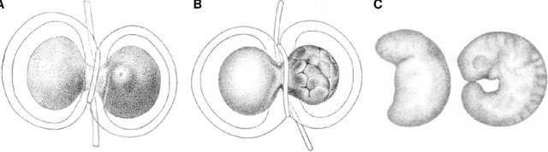
Newt blastomeres develop normally after delayed nucleation
An uncleaved fertilized egg is constricted with a hair ligature; the zygotic nucleus will form in the right-hand part, which shows the maturation spot with the 1 st polar body.
Several hours later, a nucleus from the cleaving right part (8-16 cell stage) is allowed to cross the cytoplasmic bridge and to move to the non-nucleated left part
The separated left part of the egg has given rise to a morphologically normal embryo, whose development is delayed by several hours compared to the embryo forming from the right part

Slide 11
Procedure used by Briggs and King

Slide 12
What is cloning?
Cloning is the production of one or more individual plants or animals (whole or in part) that are genetically identical to an original plant or animal. There are three types of cloning:
1. Embryo cloning
2. Nuclear transfer cloning or adult cloning (reproductive cloning)
3. Therapeutic cloning

Slide 13
Embryonic cloning
Embryonic cloning:
the blastomeres of an early embryo (2, 4 or 8-cell stage) are separated and each is grown in vitro to give an embryo which can be transferred to a surrogate mother.
The drawback of this method is that you clone an embryo that you don’t know its future traits.

Slide 14
Adult cloning: cell nuclear replacement
Involves removing the DNA (nucleus) from an oocyte and replacing it with the DNA from a cell removed from an individual. Then, the embryo would be implanted in a woman's womb and be allowed to develop into a new human whose DNA is identical to that of the original individual.
This method has been used to clone a sheep. The initial steps of the procedure were tried using human DNA in 1998. Adult DNA cloning cannot ethically be used to produce a human clone, because experiments on animals have sometimes produced defective specimens.

Slide 15
Embryo Cloning Procedure.

Slide 16
The technique used in sheep cloning (Dolly cloning, 1996)
There are some differences between the experimental technique used to clone the sheep from that used to clone frogs.
1. Instead of microinjection donor cell nuclei, they made a wide slit into the zona pellucida, to remove the polar body and meiotic spindle, and then placed the entire donor cell next to the enucleated egg.
2. The cell and egg were fused using electric shock, which also activated the egg.
3. They used starved culture cells in the G0 state which appeared to facilitate the reprogramming of the nucleus for embryonic development.
4. To insure that any lambs born didn’t result from host eggs that had not been enucleated properly or from unnoticed mating of foster ewe, eggs, and foster ewes were chosen from a race that is different from the race provided the donor cells for nuclei.

Slide 17
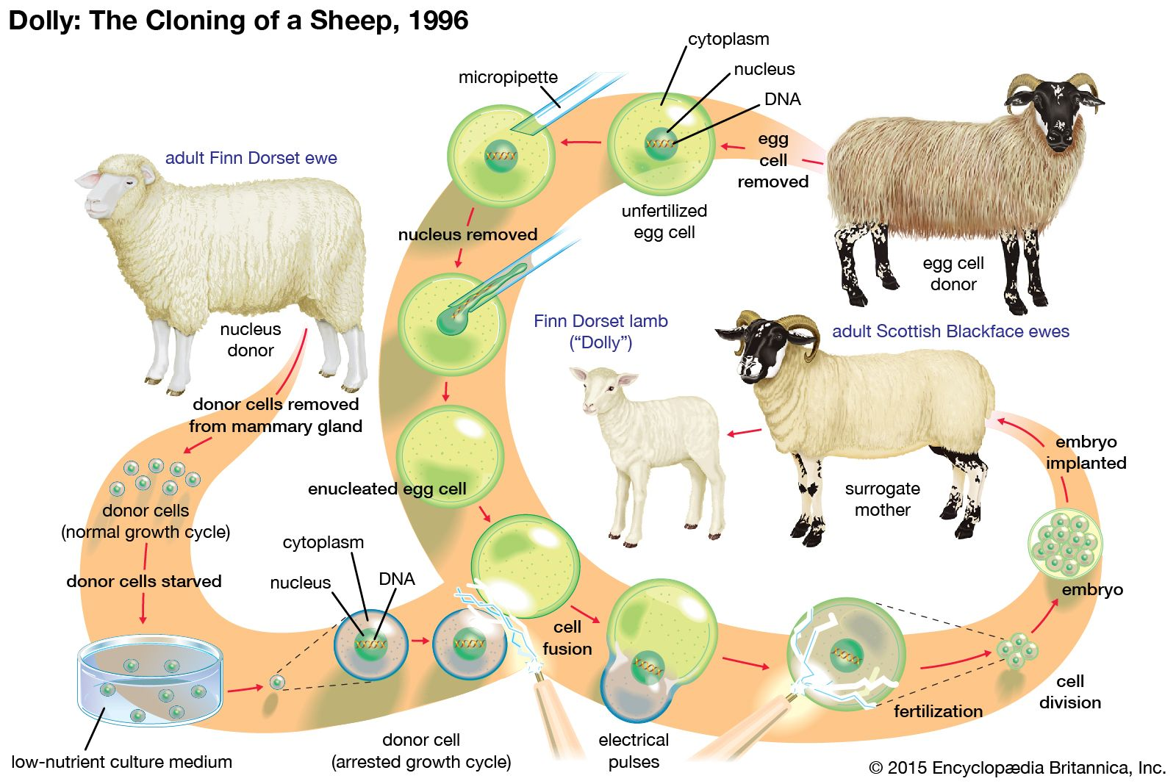
Nuclear Transfer or Adult Cloning Procedure

Slide 18
Therapeutic Cloning
Therapeutic cloning procedure is similar to the nuclear transfer or adult cloning, except that the goal of this kind of cloning is to produce an embryo at the blastocyst stage to become the source of the inner cell mass or embryonic stem cells that can be used for therapy.
Thus the objective is not producing an organism (reproductive cloning) but instead using such kind of cloning as a mean of therapy (therapeutic cloning).
Usually the genetic material (nucleus) is taking from the patient somatic cells to be transplanted into an enucleated oocyte. The genetic material of the patient somatic cells can also be modified before transferring it to the enucleated egg. The transferred inner cell mass cells or embryonic stem cells will not be rejected by the patient because the genetic material originated from the patient.

Slide 19

Therapeutic cloning procedure

Slide 20
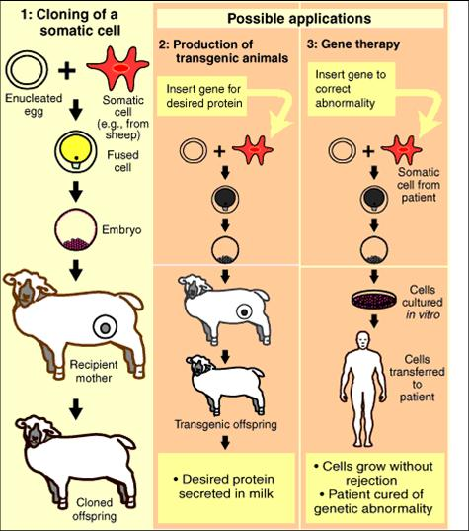
Therapeutic cloning possible applications.

Slide 21
Benefits of Therapeutic Cloning
This procedure would have a number of advantages, when compared to regular organ transplant donated by a second person:
There would be presumably no danger of rejection of the transplant because the organ's DNA would match the patient's DNA exactly.
For transplants involving a kidney (or theoretically any other organ that is duplicated in the body), another individual would not have to experience pain, inconvenience, and potentially shortened life span to donate the organ.
The patient would not have to wait until an unrelated donor dies to obtain a transplant. A new organ could be grown for them as needed.
The patient would not have to use a replacement organ that is old and may have reduced functionality; a brand-new organ would be grown specifically for them.
The procedure would save lives that would otherwise be lost waiting for a transplant that did not come in time.
The potential exists to cure, or at least treat, certain diseases and disorders that cannot be effectively handled today.

Slide 22
Problems of using therapeutic cloning
Before therapeutic cloning can become generally available to cure heart disease, diabetes, paralysis, etc., several hurdles have to be overcome:
1. Developing cures: Methods have to be developed that will cure or treat diseases with embryonic stem cells. This looks promising. Research with adult stem cells, which has been underway for many years, have shown great promise. Unfortunately, adult cells are limited in their application. Research using therapeutic cloning is a new field, but it has already shown that stem cells from embryos have much greater flexibility than adult stem cells.
2. Is an embryo a human person? Pro-life supporters generally believe that a human person comes into existence at conception. Some believe that somatic cell nuclear transfer is sufficiently similar to normal conception with an egg and spermatozoa that a human person also comes into existence during therapeutic cloning. The process of extracting stem cells involves killing the embryo. To many pro-lifers, this is murder. They feel that murdering one person, the embryo, to cure another person of paralysis, or diabetes, or heart disease, etc. can never be justified

Slide 23
Problems of therapeutic cloning
3. Stability of stem cells: As of 2003-MAR, therapeutic cloning is still in its early stages of development. Stem cells have sometimes mutated, and thus been rejected by the recipient's body. In other cases, at least with experiments on animals, they have produced tumors. Therapeutic cloning will not be feasible until these deficiencies have been overcome.
4. Where would the eggs come from? At the present stage of somatic cell nuclear transfer, Thomas Okarma, chief executive of Geron Corporation -- a leading stem-cell research establishment -- estimated that takes "100 eggs if you're lucky" to produce a useable stem cell line. This means that if a cure for diabetes involving therapeutic cloning is found, it would take 1.5 billion eggs to cure the 15 million Americans who have diabetes. Until the production of stem cells becomes more efficient, very few cures could be made for economic reasons. Even if and when techniques are found to reliably produce one custom stem cell line for each egg harvested from a woman, 15 million eggs would be required to completely wipe out diabetes. Extracting eggs from women is "painful, costly, and unreliable

Slide 24
Some benefits and ethics of human cloning
Examples of Good Human Reproductive Cloning:
1. To treat infertility.
2. To provide organ transplants
3. To replace a loved-one
4. To avoid homozygosity in case of recessive alleles (Parents are carriers)

Slide 25
Arguments against human cloning
a. Physical harms including
- damage to DNA
-Maternal and paternal imprinting
-Telomere shortening
-DNA reprogramming
b. Psychological Harms including:
-Loss of uniqueness to the child
Loss of self-worth to DNA donor
-Harms to other participants including egg donors, gestational surrogates……etc.

Slide 26
C. Harms to society including:
1. Confusing family and generational structure, because so many participants including
-genetic donor
-egg donor
-gestational mother
-rearing function
2. Encouraging genetic enhancement
Systemic selection of genetic traits in offspring (eugenic)
3. Distribution justice (cloning for the rich)
4. Commercializing the family
5. Reducing genetic diversity
6. preventing random selection and genetic recombination
- to reduce human survival with ongoing environmental changes
7. Increasing the population size

Slide 27
8. Threatening socially important values
-individuality
-privacy
-autonomy
D.. Unnatural or immoral
- Playing God
-Unethical
E. Difficult to regulate

